Slide 2

Presented by
AKASH BUSSA

Slide 3


Slide 4
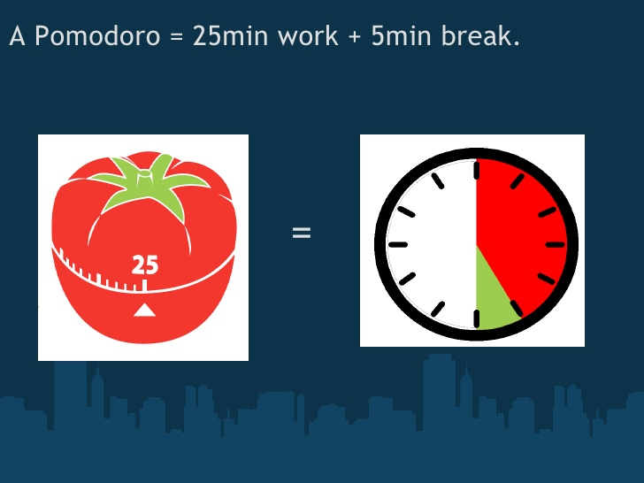

Slide 5
What is it?
The pomodoro technique was developed by Francesco Cirillo in the late 80’s while at university.
The pomodoro technique was created with the aim of using time as a valuable ally to accomplish
what we want to do the way we want to do it, and to empower us to continually improve our work or
study processes.
It’s a way of managing your time!

Slide 6
SCRUM RELATED TO POMODORO TECHNIQUE
1.PRODUCT BACKLOG ACTIVITY INVENTORY LIST
2.SPRINT BACKLOG TO DO TODAY LIST
3.SPRINT LENGTH POMODORO LENGTH
4.REVIEW ASSESSMENT AT END OF THE DAY
5.RETROSPECTIVE ASSESSMENT AT END OF THE DAY

Slide 7
Steps to be followed
1.Choose a task
2.Set time for 25 minutes
3.Work on that task without stopping
4.When time is up , stop for five minutes.

Slide 8
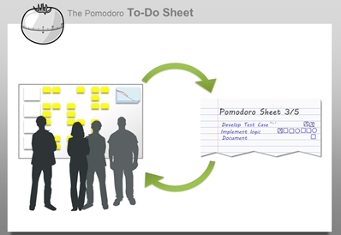

Slide 9
Six objectives
1.Find out how much activity and pomodoro tasks.
2.Learn to protect your pomodoro from internal and external interruptions.
3.Make accurate estimation of how many pomodoros we need for activity.
4.Spend on work ,but before do a recap at beginning and a review at the end.
Recap---->work------>review
5.Set timetable according to your time. Good for organizing work.
6.Find personnel objective like checking and improving efficiency or quality of your work.

Slide 10
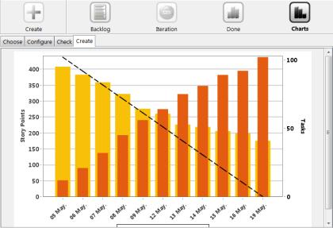

Slide 11
THANK YOU

